Slide 1

Adult Depression (LGHC Indicator)
Ryan Coslove (rmc326)

Slide 2
The Data
Resource: https://www.kaggle.com/yamqwe/adult-depression-lghc-indicatore/version/2
This set contains data displays the proportion of adults who were ever told they had a depressive disorder in California.
This indicator is based on the question: "“Has a doctor, nurse or other health professional EVER told you that you have a depressive disorder (including depression, major depression, dysthymia, or minor depression)?”
This set of data contains categories, such as sex, age, income; as well as numerical data like 95% Confidence Level values and frequency values.
Official attributes: Year, Strata, Strata, Name, Frequency, Weighted Frequency, Percent Lower 95% CL, Upper 95% CL

Slide 3
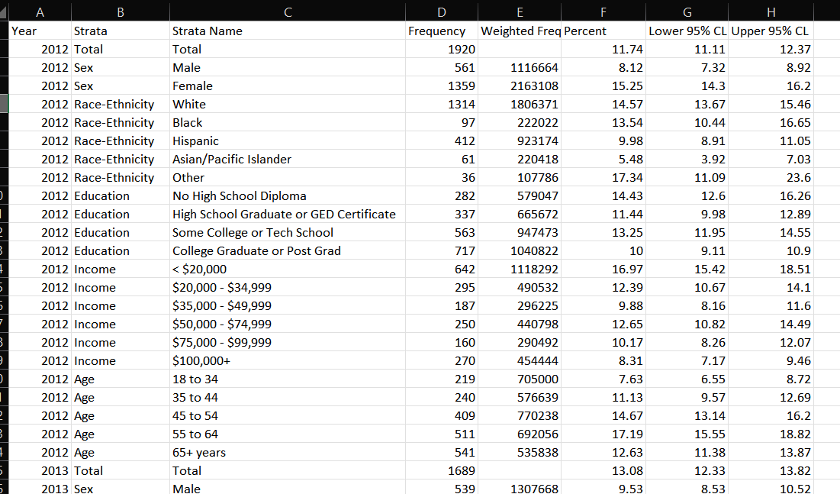
Example

Slide 4
What can be done with this data?
The data can be analyzed to show which residents of California in the study have been diagnosed with (a variation of) depression.
The data can show which demographics are most or least likely to be diagnosed with depression
Demographics such as:
Sex
Race/Ethnicity
Education
Income
Age

Slide 5
What makes this data useful?
This data set could be combined with a second set detailing how those demographics and others on a national and or state level ○ For example: https://catalog.data.gov/dataset/indicators-of-anxiety-or-depression-based-on-reported-frequency-of-symptoms-during-last-7-
Analysis of these data sets could find correlations between which demographics and in which locations receive the highest and lowest amounts of diagnoses of depressions.
These two data sets could then be used together to predict what demographics are most likely to be diagnosed with depression, as well as which locations might be most likely to give a diagnoses.
These data sets can teach us which demographics might need more mental health resources.

